Slide 2


Slide 3
Modelling
Model validation
Model combination

Slide 4
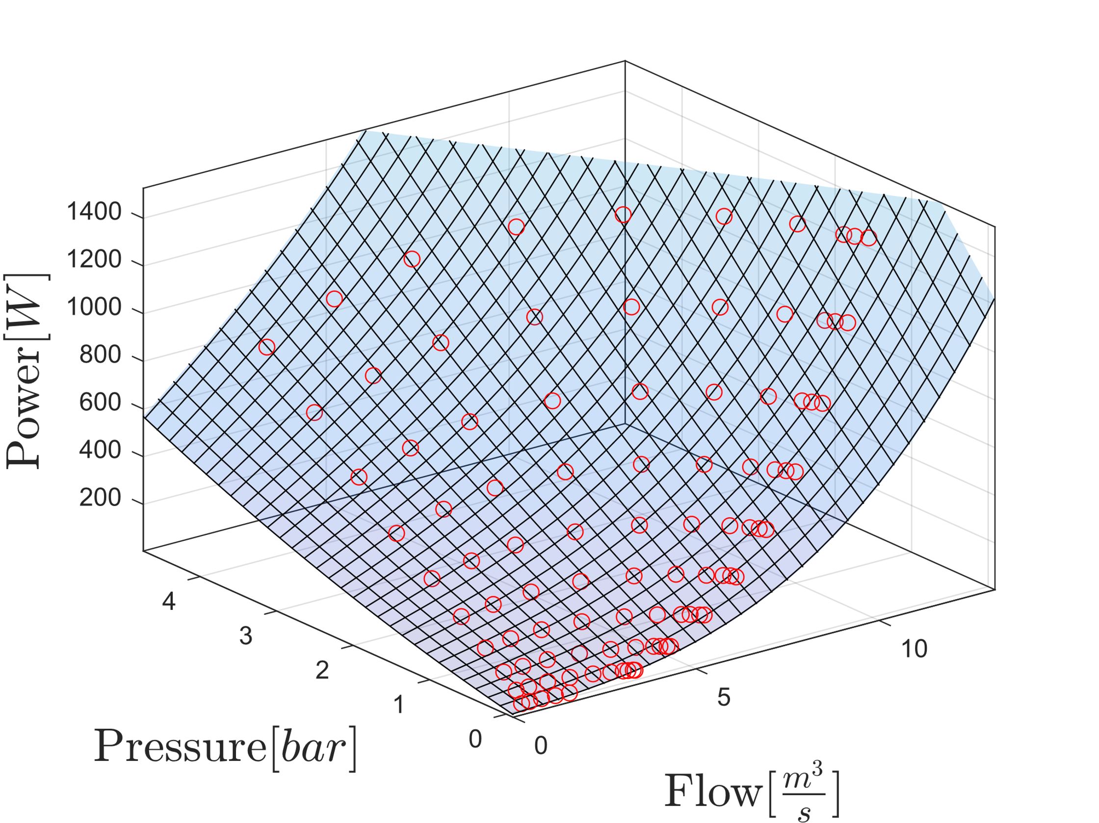
Power consumption
Model for single pump

Slide 5
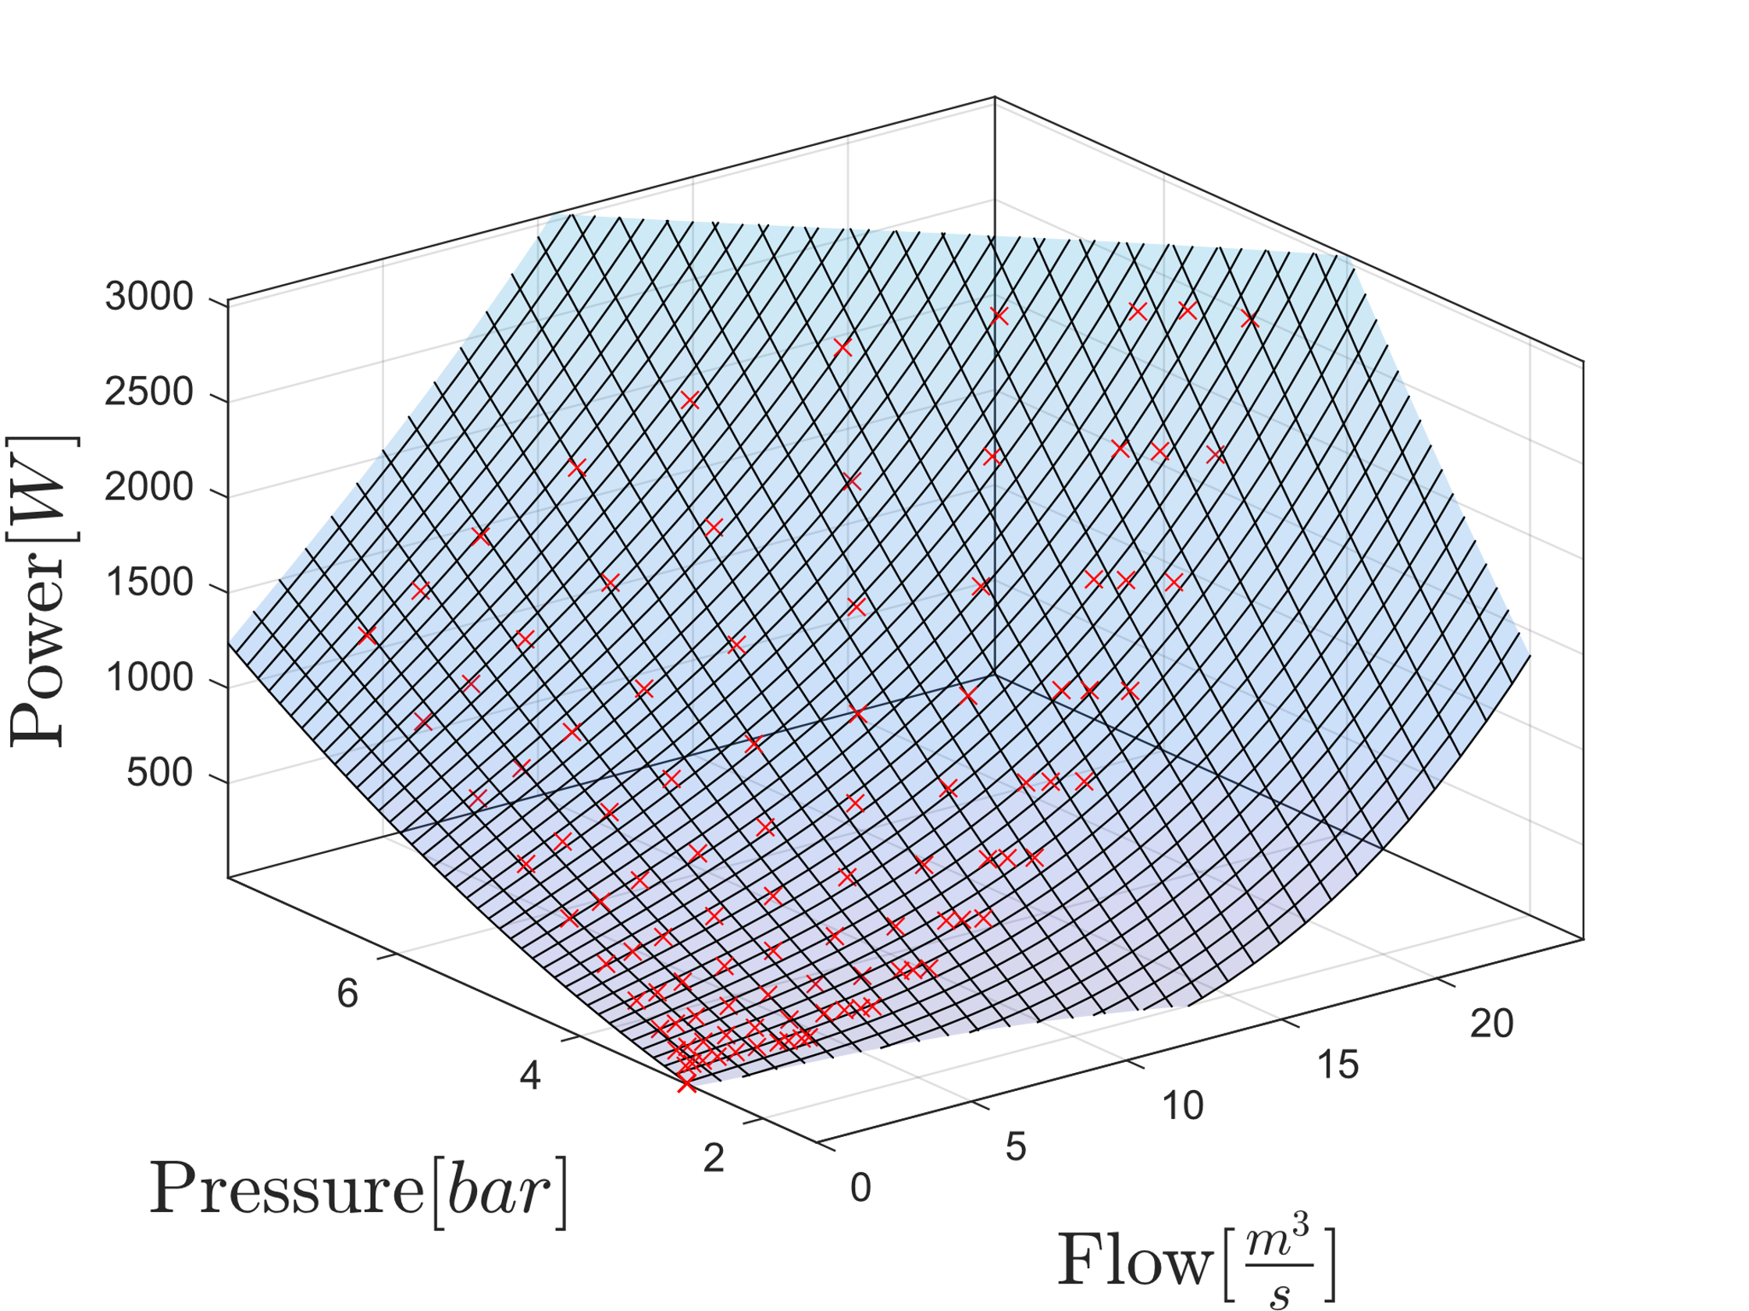
Power consumption
Model for two pumps

Slide 6
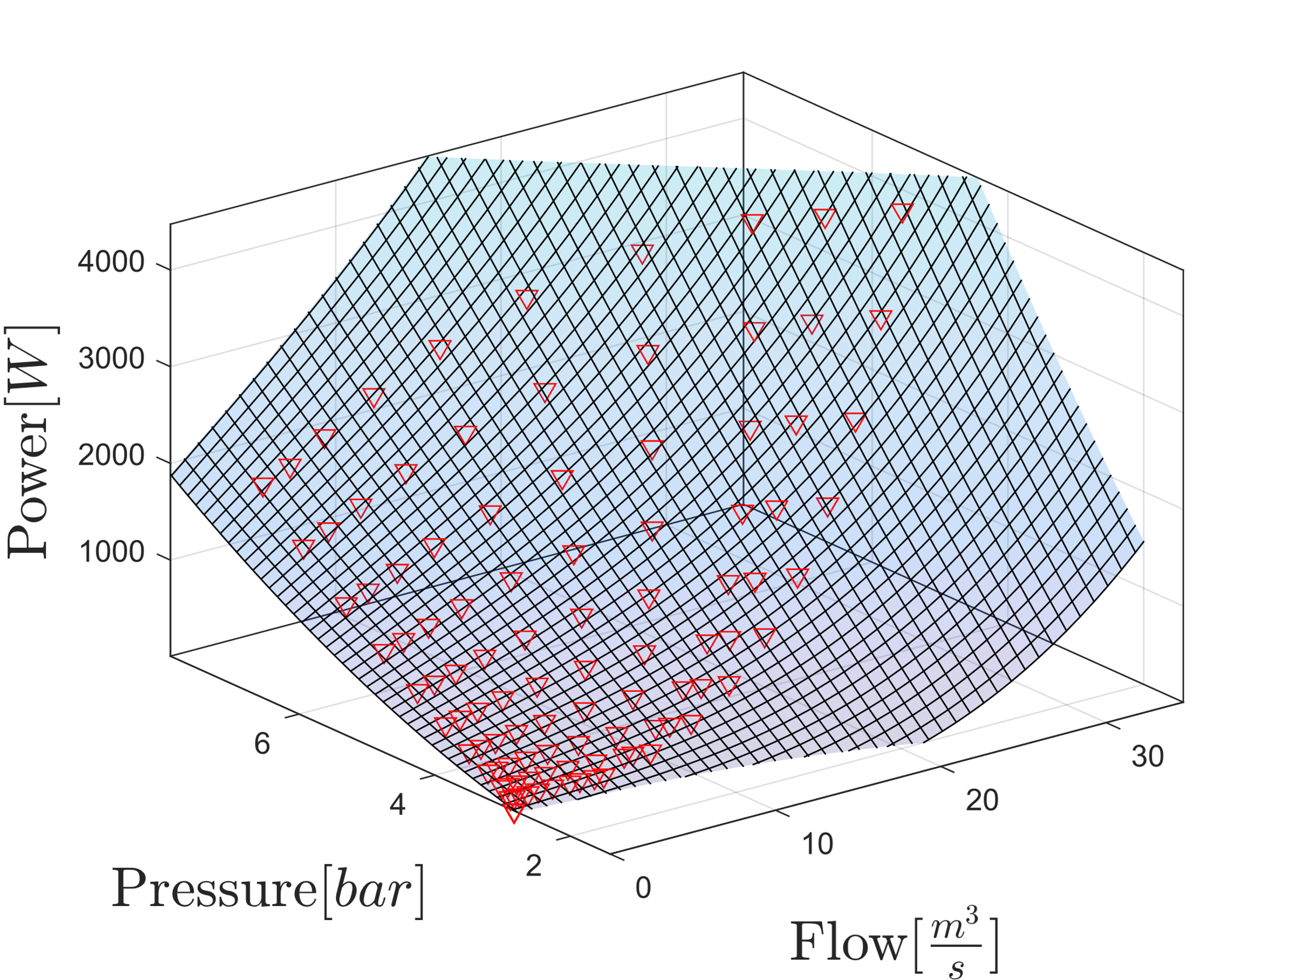
Power consumption
Model for three pumps

Slide 7
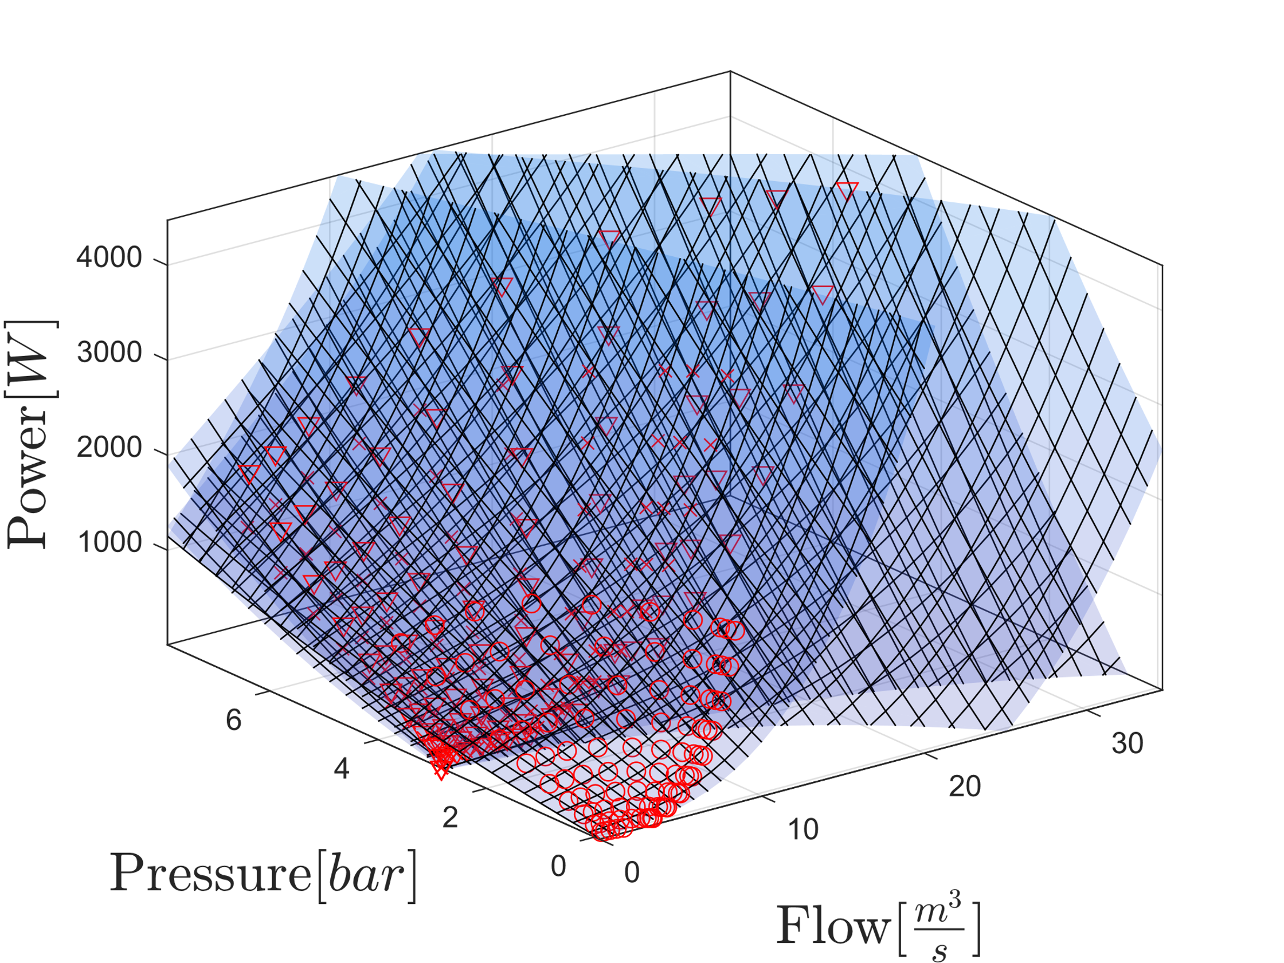
Power consumption
Combined Model

Slide 8
